Slide 1
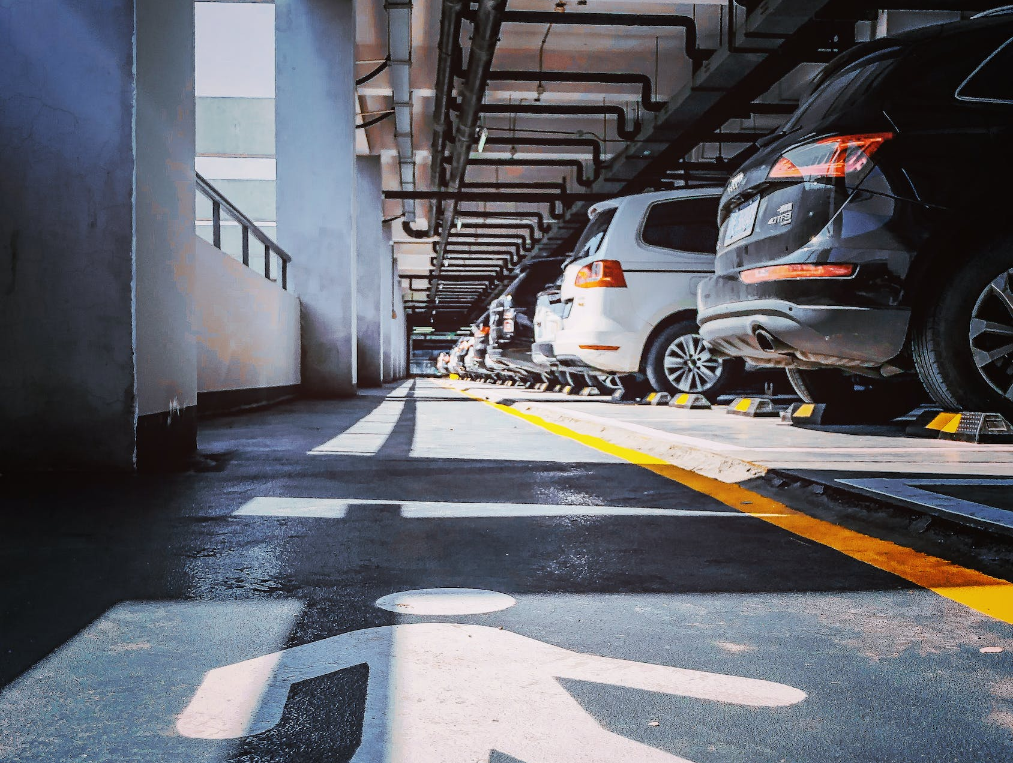
Car Parking System
M Sita Chandra AP20110010782
B Bhargav AP20110010785
V Chaitanya AP20110010787
G Sumana Sree AP20110010808
T Dhanasri AP20110010781

Slide 2
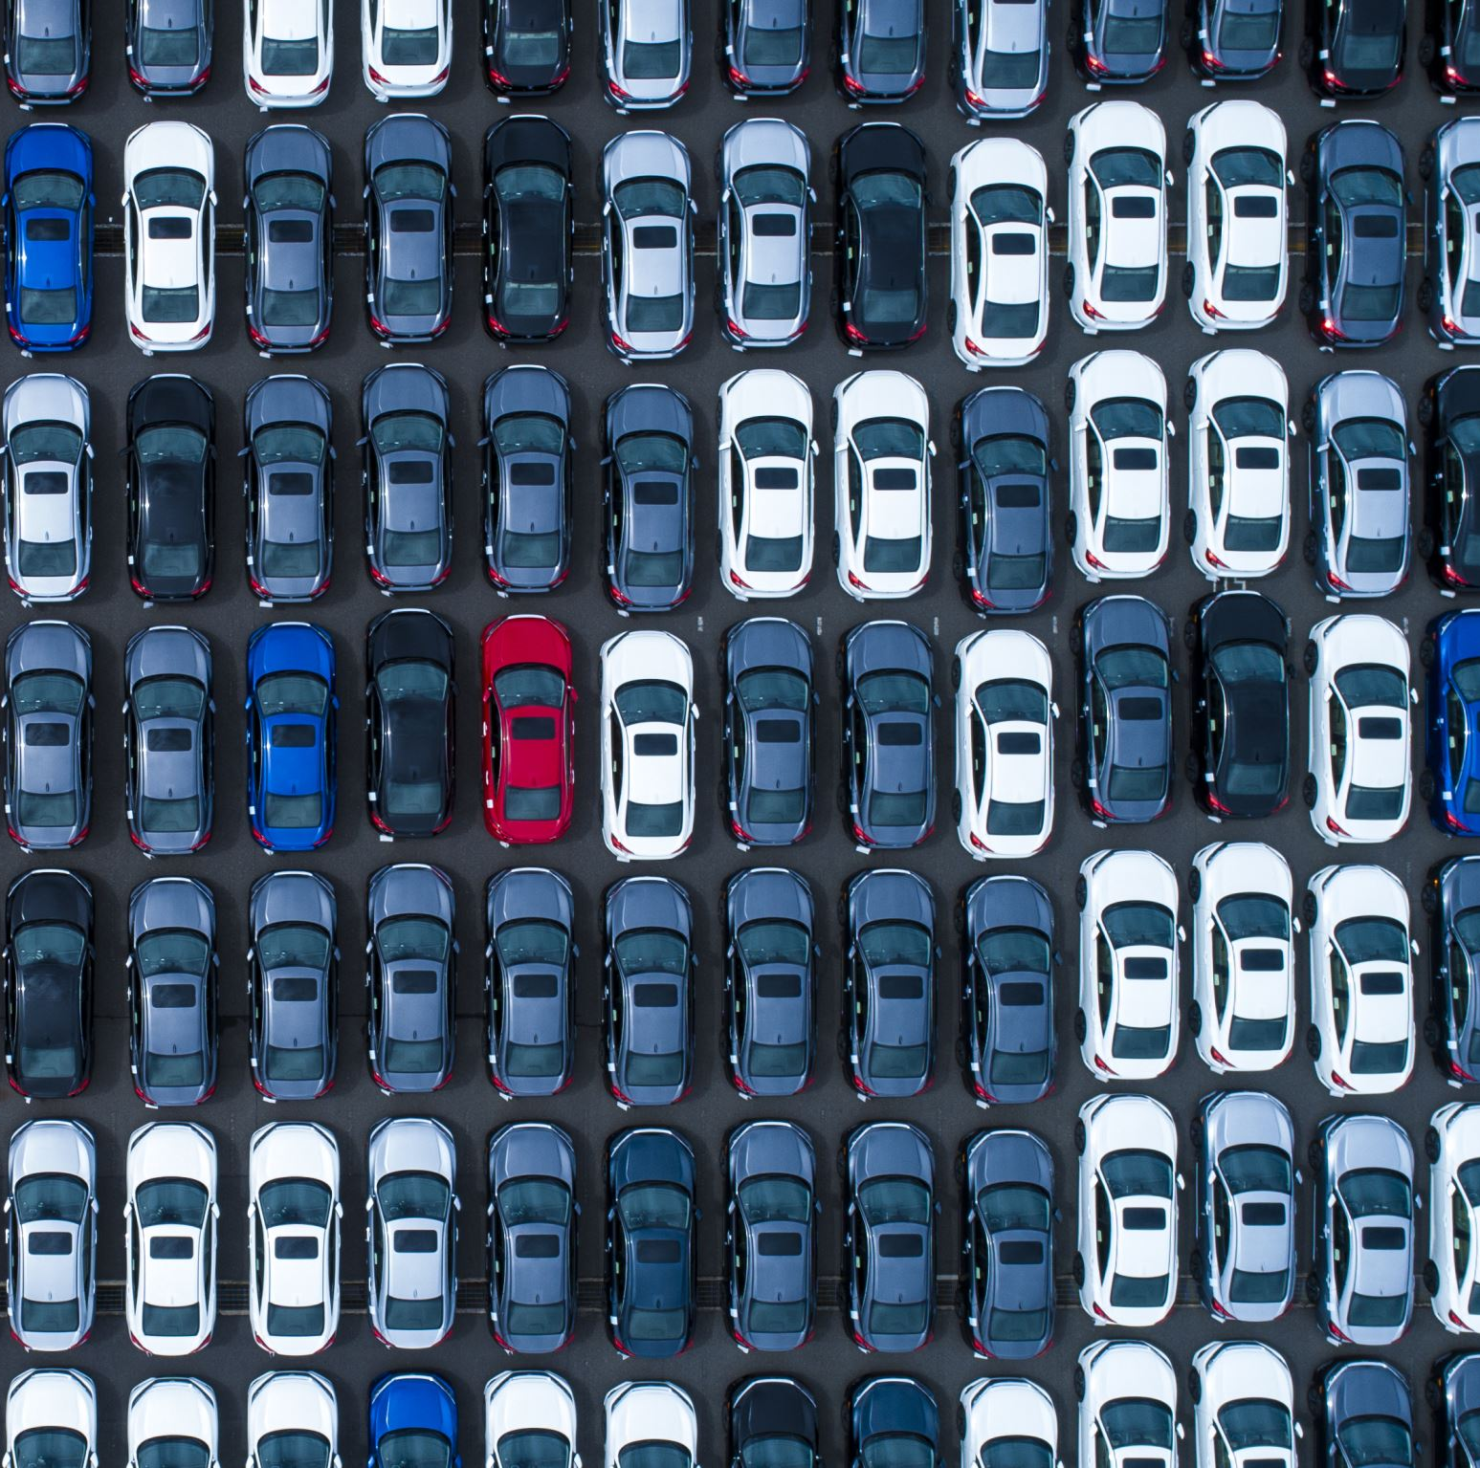
Introduction
A web-based car parking system manages records of incoming and outgoing cars in a parking area. It utilizes web technology for efficient data management. Users can access the system through a web interface. The system records vehicle details, tracks entry and exit times, and manages parking permits. It provides a centralized platform for monitoring and analyzing parking data. The system enhances efficiency and accuracy in managing parking operations.
Admins can easily retrieve data of vehicles that have used the parking system. They have full control over vehicle entry and exit. The system provides seamless access to data for efficient retrieval. Admins can monitor and manage all vehicles using the parking system. The system ensures secure and reliable data retrieval for administrative purposes.

Slide 3
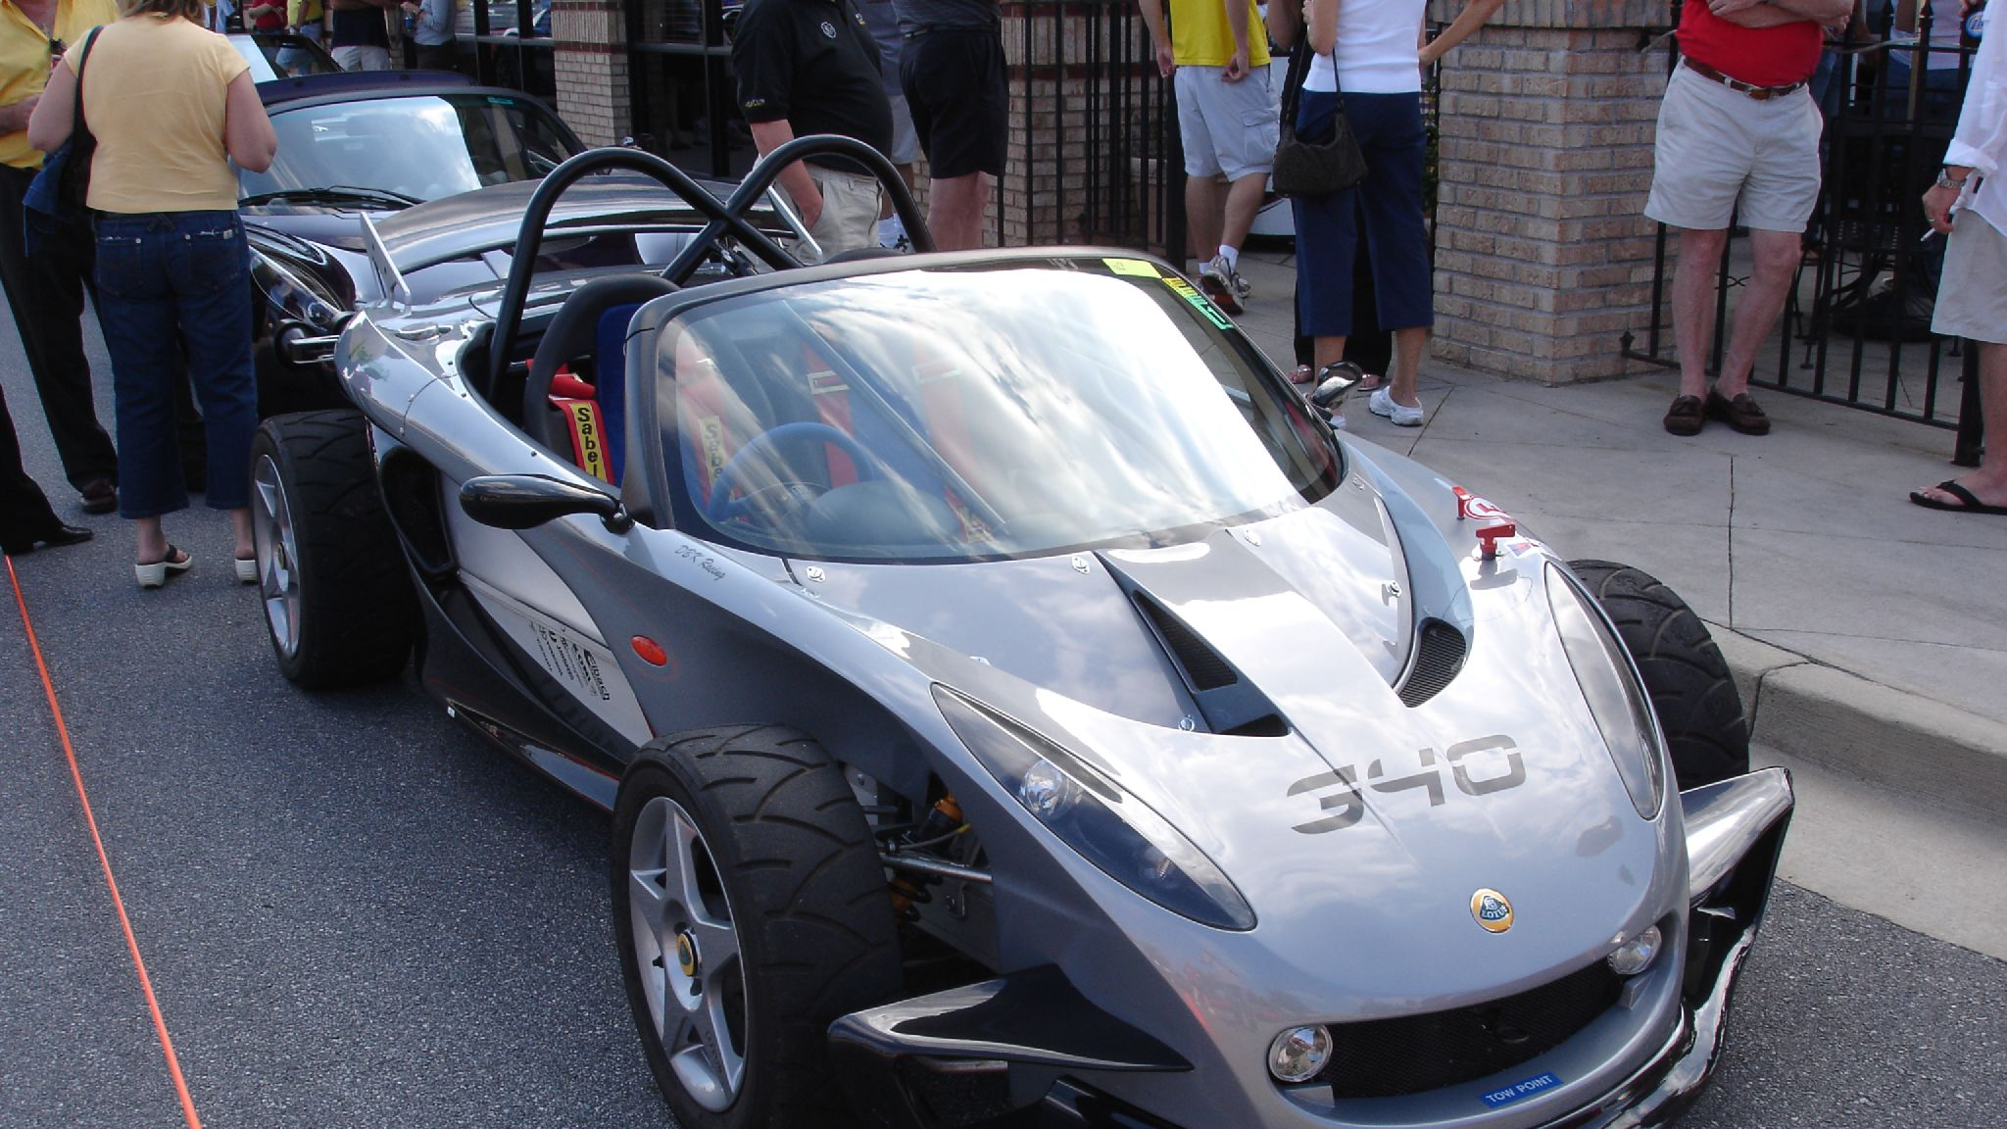
Introduction
The car parking management system is an automated solution that processes data rapidly and systematically. It ensures high-speed data processing for efficient operations. The system streamlines and organizes data in a systematic manner. It handles parking-related tasks with speed and precision. The system offers fast and reliable data processing for effective management.

Slide 4

Existing system
Currently, visitor parking tasks are manually handled using paper-based methods. Yearly visitor parking records are stored in registers. Generating reports according to specific requirements is time-consuming due to manual calculations. This paper-based system lacks efficiency and flexibility in generating reports. It is difficult to analyze visitor parking data in a timely manner. The need for a faster and more efficient solution is evident. An automated system can streamline visitor parking management and provide faster report generation based on specific needs. Transitioning to a digital system would enhance efficiency and improve data analysis capabilities.

Slide 5

Existing system
Disadvantage of present system:
Not user friendly: The present system not user friendly because data is not stored in structure and proper format.
Manual Control: All report calculation is done manually so there is a chance of error.
Lots of paper work: Visitors maintain in the register so lots of paper require storing details.
Time consuming

Slide 6
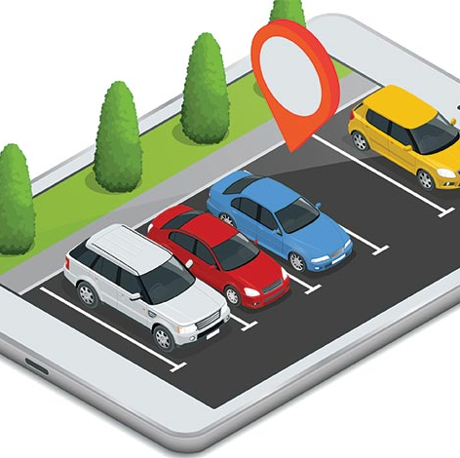
Methodology
Requirement Analysis - At this step we gather all the information in order to build the project.
System Design - Creating a comprehensive architecture and component plan to ensure efficient and effective implementation of the system.
Database Design - This step involves structuring and organizing data to efficiently store and manage parking lot information, user details, etc.

Slide 7

Methodology
Front-end Development -At this step we design user interface. The user interface using HTML, CSS, and JavaScript are implemented in this project.
Back-end Development -At this step everything takes place at server side. PHP is utilized as the server-side scripting language to handle the logic and business processes of the car parking system
Integration and Testing -Integrate the front-end and back-end components of the car parking system. Conduct comprehensive testing to ensure the system functions correctly, handles edge cases, and performs optimally.

Slide 8
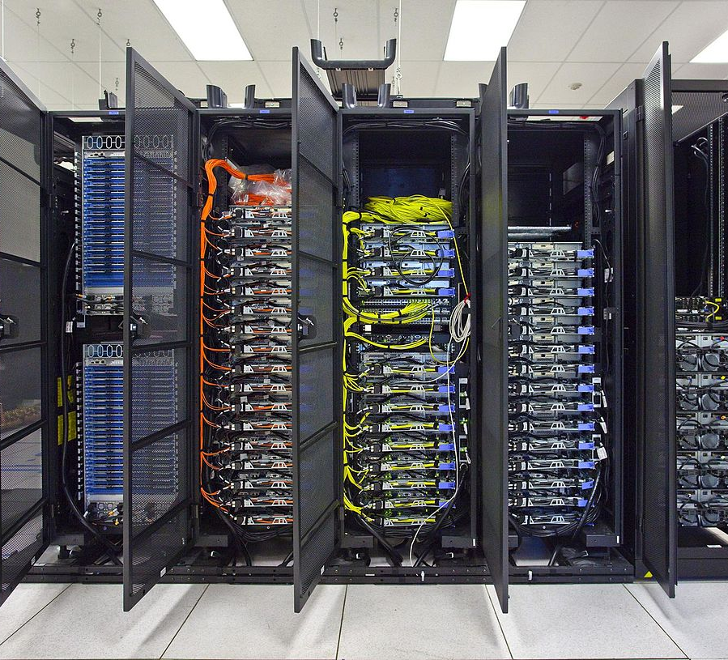
Technologies
The appropriate web development technologies for the project, considering factors such as compatibility, scalability, performance, and ease of implementation. Technologies like HTML, CSS, JavaScript, PHP, and MySQL are selected to fulfill the system requirements.
In the system, we use PHP and MySQL database. We also use Html, CSS, JavaScript and web servers like Xampp. This is the project which keeps records of the vehicles which are going to parking lot in the parking area.
This Photo by Unknown author is licensed under CC BY-SA.

Slide 9
System Requirements
Hardware Configuration:
Client Side:
Server side:
RAM | 512 MB
Hard disk | 10 GB
Processor | 1.0 GHz
RAM | 1 GB
Hard disk | 20 GB
Processor | 2.0 GHz

Slide 10
System Requirements
Software Requirement
Client Side:
Server Side:
Web Browser | Google Chrome or any compatible browser
Operating System | Windows or any equivalent OS
Web Server | APACHE
Server side Language | PHP5.6 or above version
Database Server | MYSQL
Web Browser | Google Chrome or any compatible browser
Operating System | Windows or any equivalent OS

Slide 11
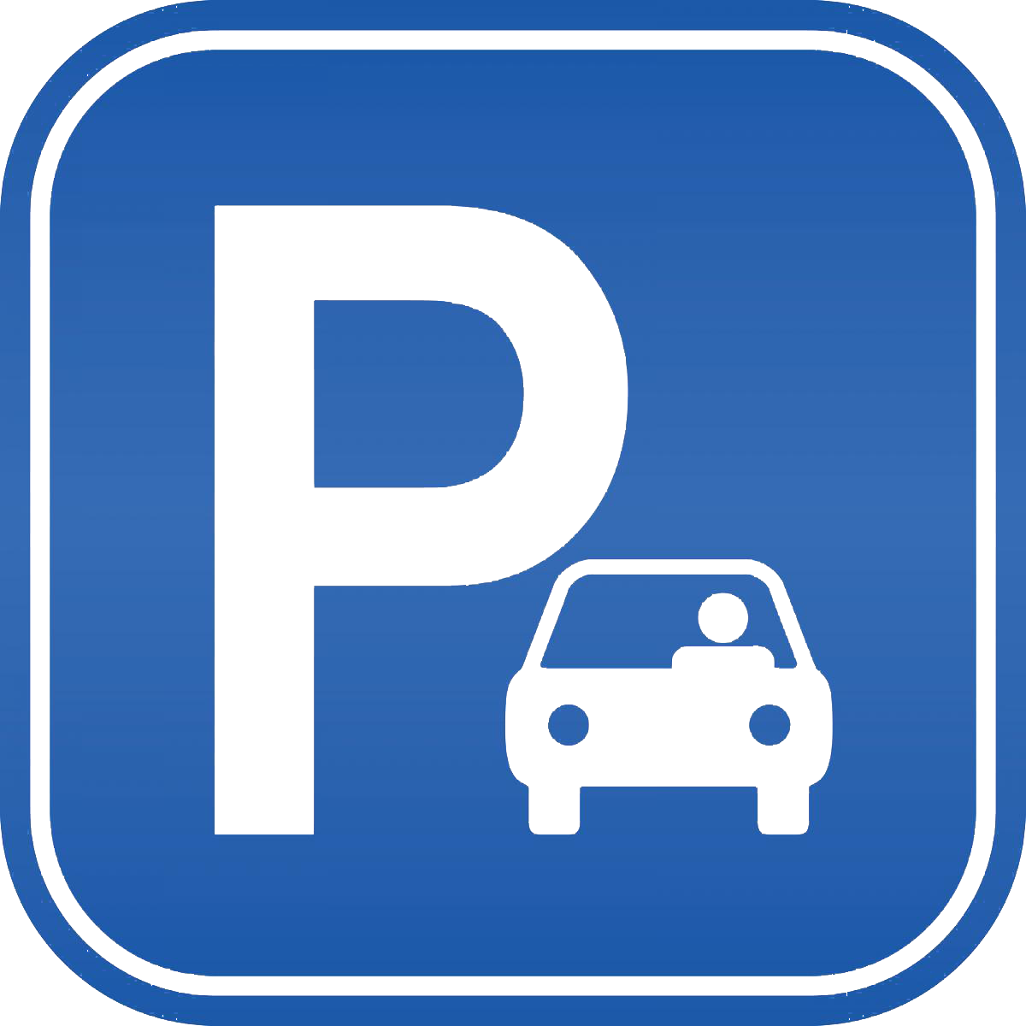
Proposed system
Our proposed car parking system consists of a web-technology based system which has admin and user as the main entities.
The admin has the controls of entering incoming vehicle details and the user details of the vehicle, the user has the option to view the details of their vehicle.
The user could view the parking charges leveraged on him/her and can also print his/her parking receipt.
The admin has the options to view the registered users and can also record the outgoing vehicles from the parking lot
This system has two modules:
Admin
User

Slide 12
Proposed System
Admin module
The admin can briefly view the number of vehicle entries in a particular period. The number of vehicles which have entered the parking area today, the previous day and the last 7 days are displayed on the dashboard. He can add a car, manage car charges, access all car reports, parking numbers of every vehicle. Admin can also update his profile, change the password and recover the password.
Admin back-end table: The admin table consists of the information related to the admin such as name, mobile number, email, etc.

Slide 13
Proposed System
User module
In this section, the users can view the details of their car, which is parked by him/her. The user can also print their details or their parking receipt. Users can also update his profile, change the password and recover the password.
User back-end table:
The users table contains the information of all the users that have registered through the register page of the car parking system.

Slide 14

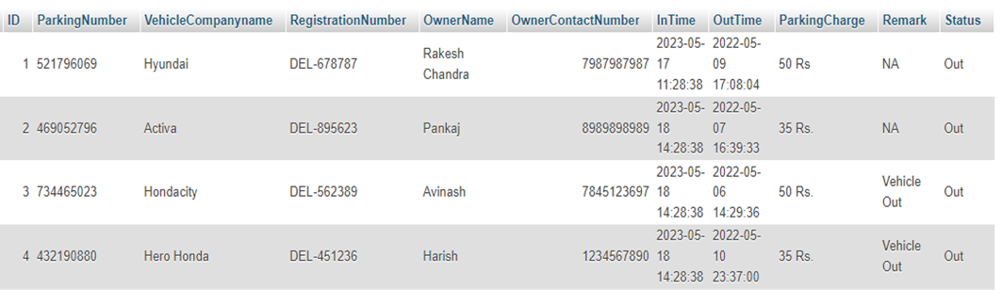
Proposed System
There is another major database table in back-end
Vehicle Table:
The vehicle table contains the information of all the cars that have entered and exited the parking area. It also contains the information of the user that uses the vehicle(car).

Slide 15
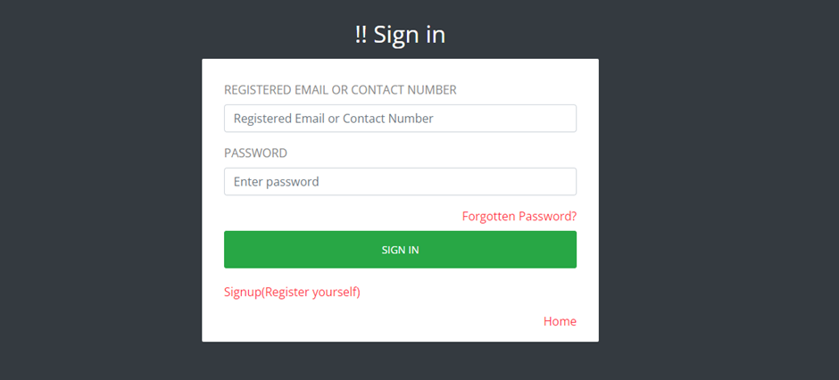
Results
Sign in page

Slide 16
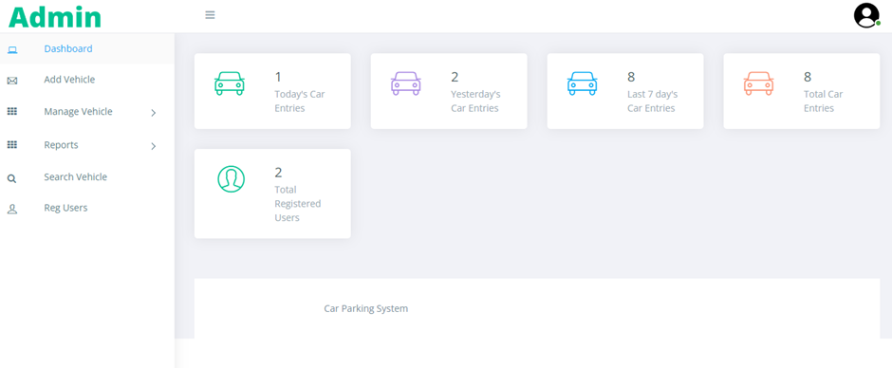
Results
Admin Dashboard

Slide 17
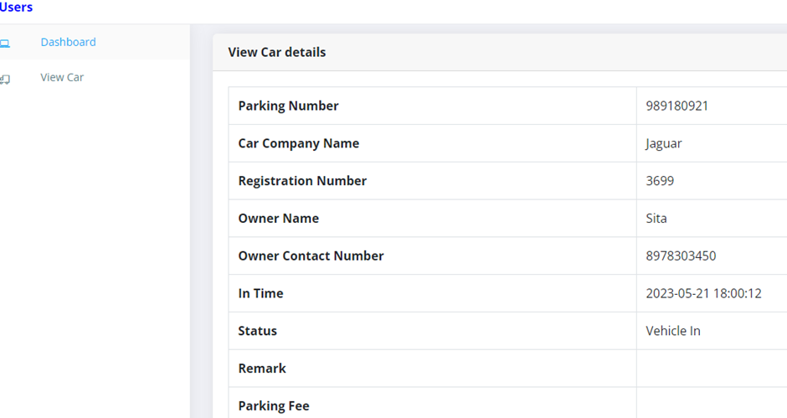
Results
User dashboard

Slide 18
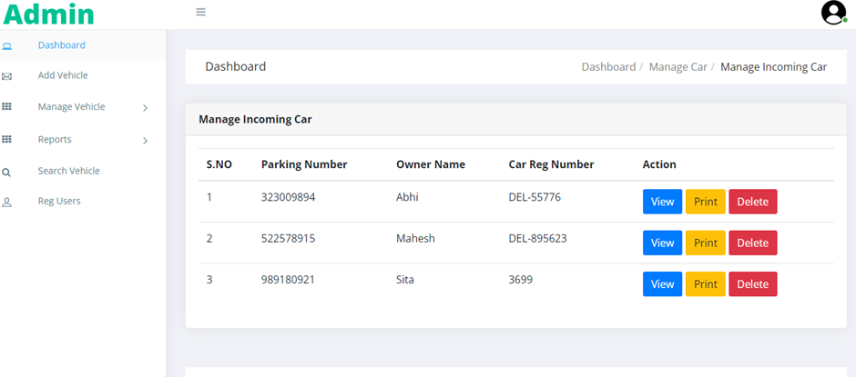
Results
Admin can see/update all parked user's details

Slide 19
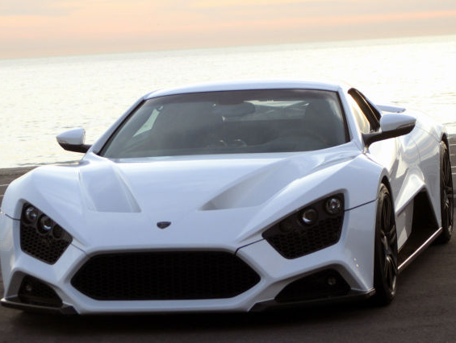
Conclusion
In conclusion, a car parking system project holds immense potential to revolutionize parking management, reduce traffic congestion, and improve the overall parking experience. By leveraging web technologies, incorporating user-friendly interfaces, and embracing data-driven insights, the system can optimize parking operations, enhance convenience, and contribute to creating smarter and more sustainable urban environments.

Slide 20

Future Work
In future we would like to explore the integration of smart technologies into the parking system, such as sensors and IoT devices. This can enable real-time monitoring of parking space occupancy, intelligent parking guidance, and automated payment processes. Implementing smart parking solutions can further optimize parking operations and enhance user convenience.

Slide 21

References
For PHP
https://www.w3schools.com/php/default.asp
https://www.sitepoint.com/php/
https://www.php.net/
For MySQL
https://www.mysql.com/
http://www.mysqltutorial.org
For XAMPP
https://www.apachefriends.org/download.html

Slide 22


